Slide 1
Nathaniel Gray – Kinase Inhibitor -Cellpainting

Slide 2
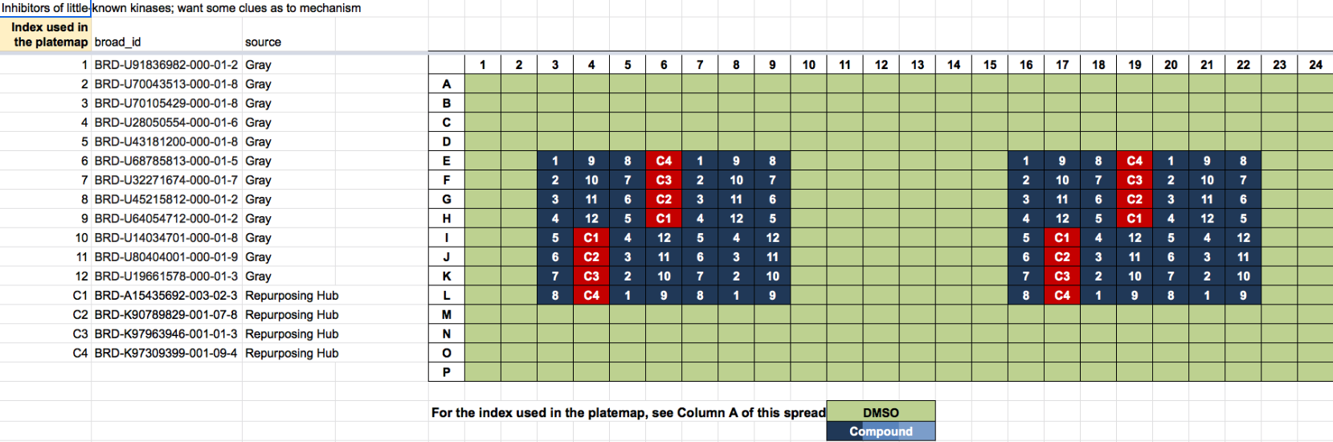
Plates: 2
Cell lines
C-7210-01-CMP-008-gray
U2OS
C-7210-01-CMP-008-gray
A549

Slide 3
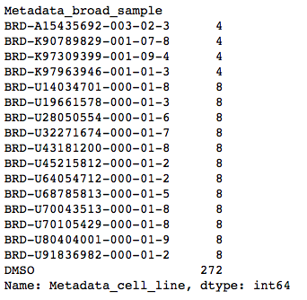
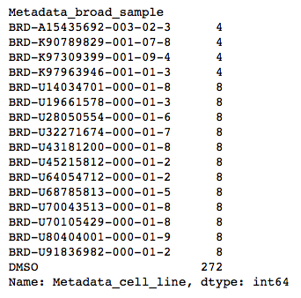
Replicates
C-7210-01-CMP-008-gray_A549
C-7210-01-CMP-008-gray_U2OS
C1
C1
C2
C2
C4
C4
C3
C3
C3 : EMD-1214063 positive controls C4: positive controls
C2: Nefadozone negative controls
C1: BMY-14802. negative controls

Slide 4
Selected feature no: 598

Slide 5
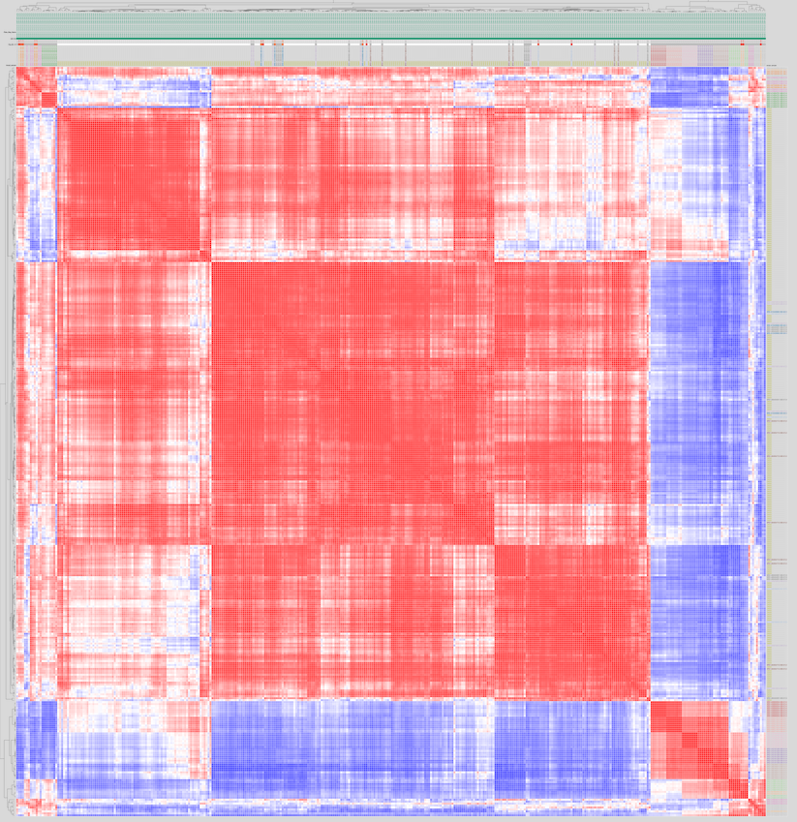
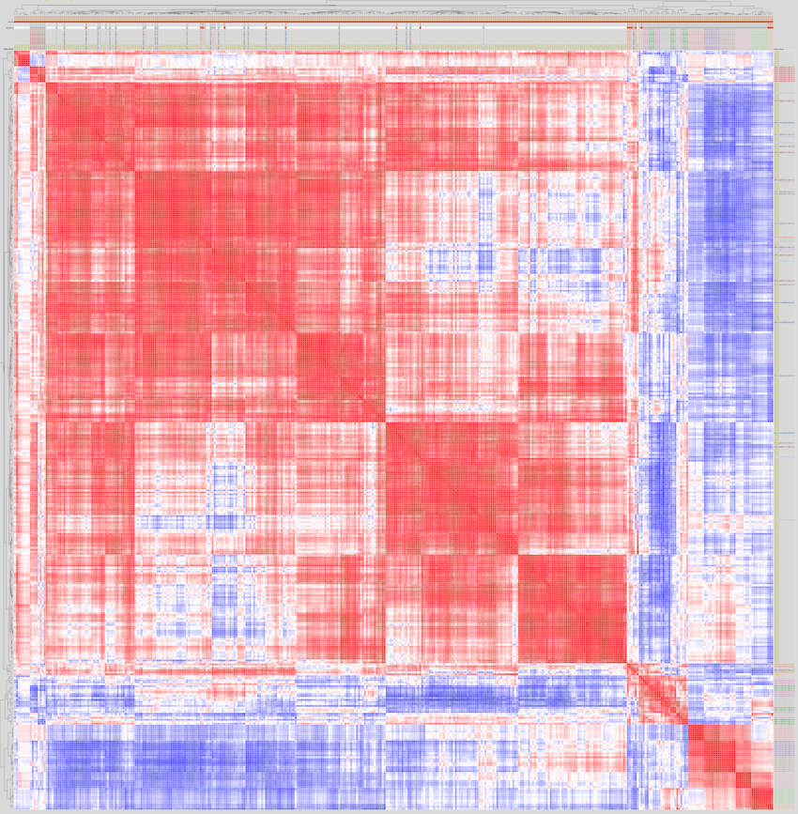
C-7210-01-CMP-008-gray_A549
C-7210-01-CMP-008-gray_U2OS
Compounds with distinct profiles compared to control

Slide 10
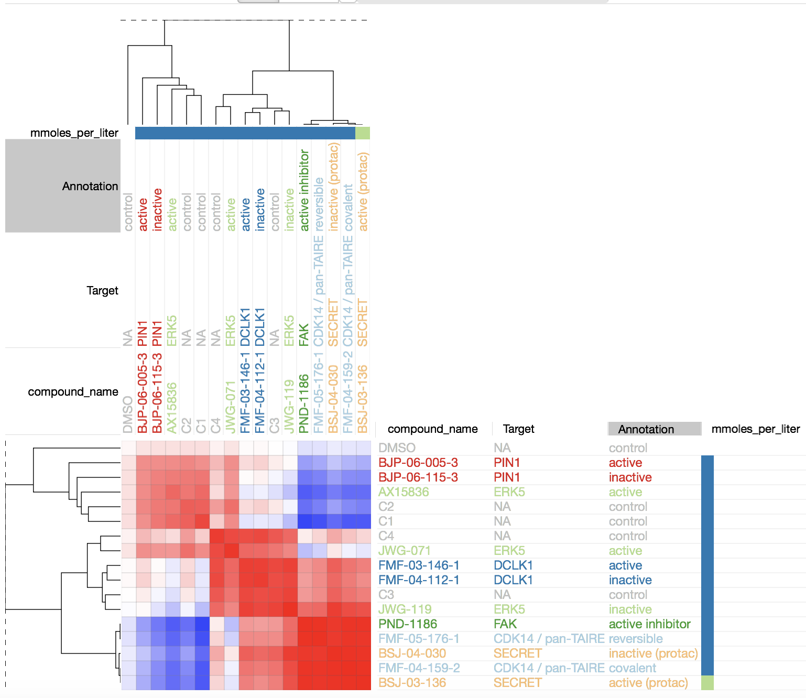
Strategy: Variables normalization by subsampling of controls (DMSO-112)
C-7210-01-CMP-008-gray_A549

Slide 11
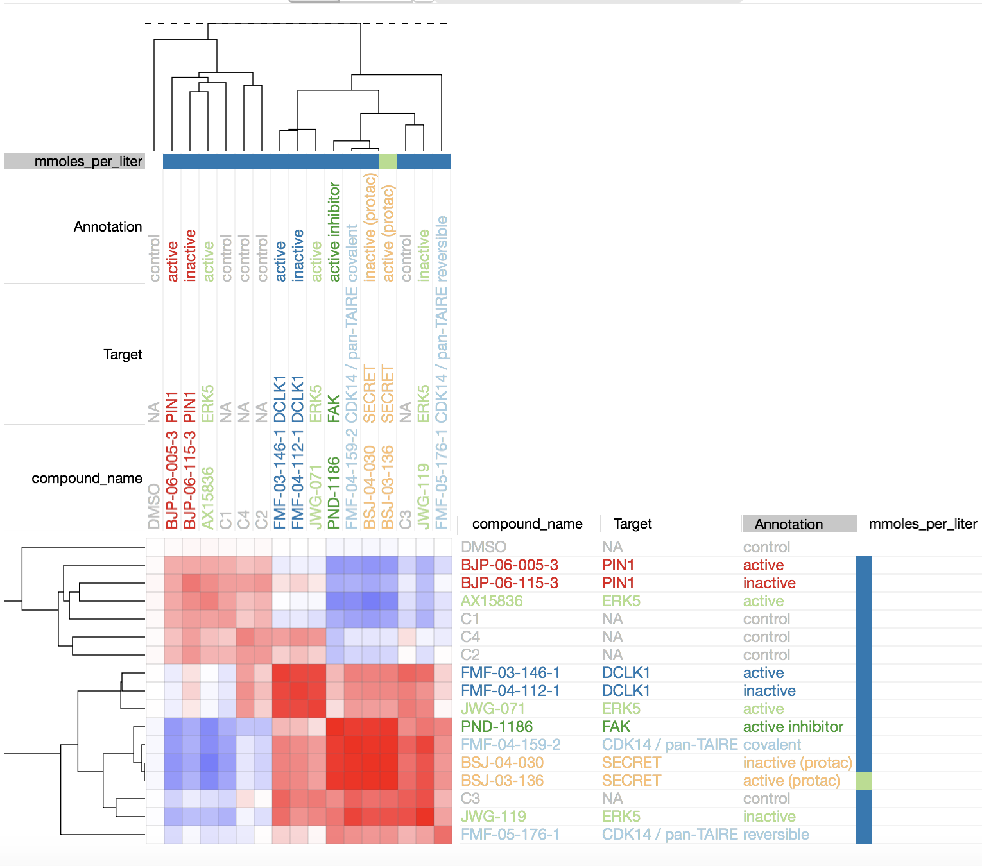
Strategy: Variable normalization by subsampling of controls (DMSO-112)
C-7210-01-CMP-008-gray_U2OS
New

Slide 12
Kurskal Wallis Test Cells_AreaShape_Area
A549 |  | Statistics | P-Value
BJP-06-005-3 | active | 0.17647058823529704 | 0.6744240722352912 | PIN1
BJP-06-115-3 | inactive
BSJ-03-136 | active (protac) | 11.294117647058826 | 0.000777530446940383 | SECRET
BSJ-04-030 | inactive (protac)
FMF-03-146-1 | active | 1.102941176470594 | 0.2936215439289016 | DCLK1
FMF-04-112-1 | incactive
FMF-04-159-2 | covalent | 4.411764705882355 | 0.0356919001168044 | CD14/pan-TAIRE
FMF-05-176-1 | reversible
JWG-071 | active | No significant different from DMSO 11.294117647058826 | 0.000777530446940383 | ERK5
AX15836 | active
JWG-119 | inactive
PND-1186 | active | ---- | ----- | FAK
kruskal

Slide 13
Kurskal Wallis Test Cells_AreaShape_Area
U2oS |  | Statistics | P-Value
BJP-06-005-3 | active | No significant different from DMSO 0.2757352941176521 | 0.5995101785599999 | PIN1
BJP-06-115-3 | inactive
BSJ-03-136 | active (protac) | 10.599264705882355 | 0.0011313264268228347 | SECRET
BSJ-04-030 | inactive (protac)
FMF-03-146-1 | active | 4.411764705882355 | 0.0356919001168044 | DCLK1
FMF-04-112-1 | incactive
FMF-04-159-2 | covalent | 11.294117647058826 | 0.000777530446940383 | CD14/pan-TAIRE
FMF-05-176-1 | reversible
JWG-071 | active | No significant different from DMSO 11.294117647058826 | 0.000777530446940383 | ERK5
AX15836 | active
JWG-119 | inactive
PND-1186 | active | ---- | ----- | FAK

Slide 14
Active, ERK5
Active, PIN1
Inactive, PIN1
DMSO
Active, Secret
Inactive, Secret
ERK5 (Active)
DCLKI
Active, DCLKI
Inactive, DCLKI
ERK5
Covalent, CDK14
Reversible, CDK14
Secret
Active, ERK5
CDK14
Inactive, ERK5
Active, FAK

Slide 15
Principal Component analysis
Active, ERK5
Active, PIN1
Inactive, PIN1
Active, Secret
Inactive, Secret
DMSO
Active, DCLKI
Inactive, DCLKI
Covalent, CDK14
Reversible, CDK14
Active, ERK5
Inactive, ERK5
Active, FAK

Slide 16
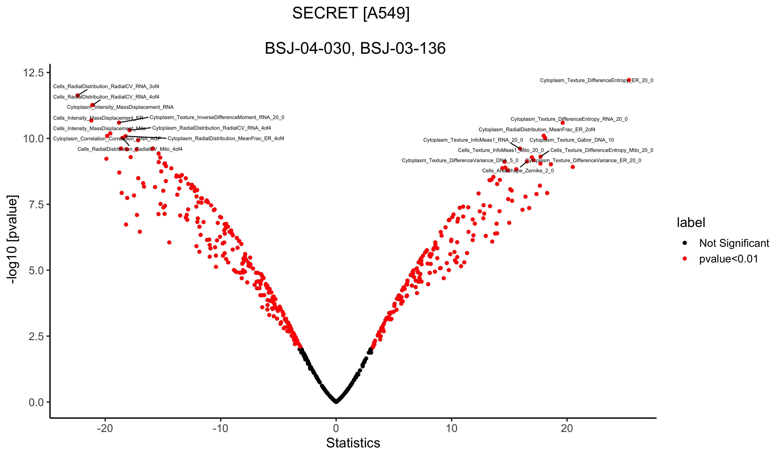
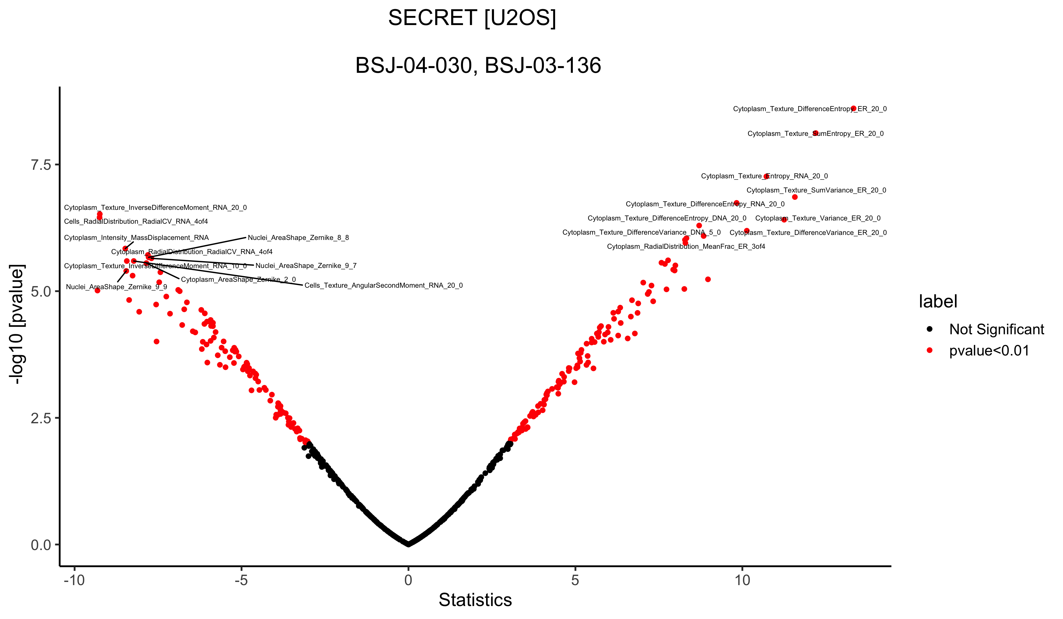
In active
Active
In active
Active
SECRET
Welch's t-test

Slide 17
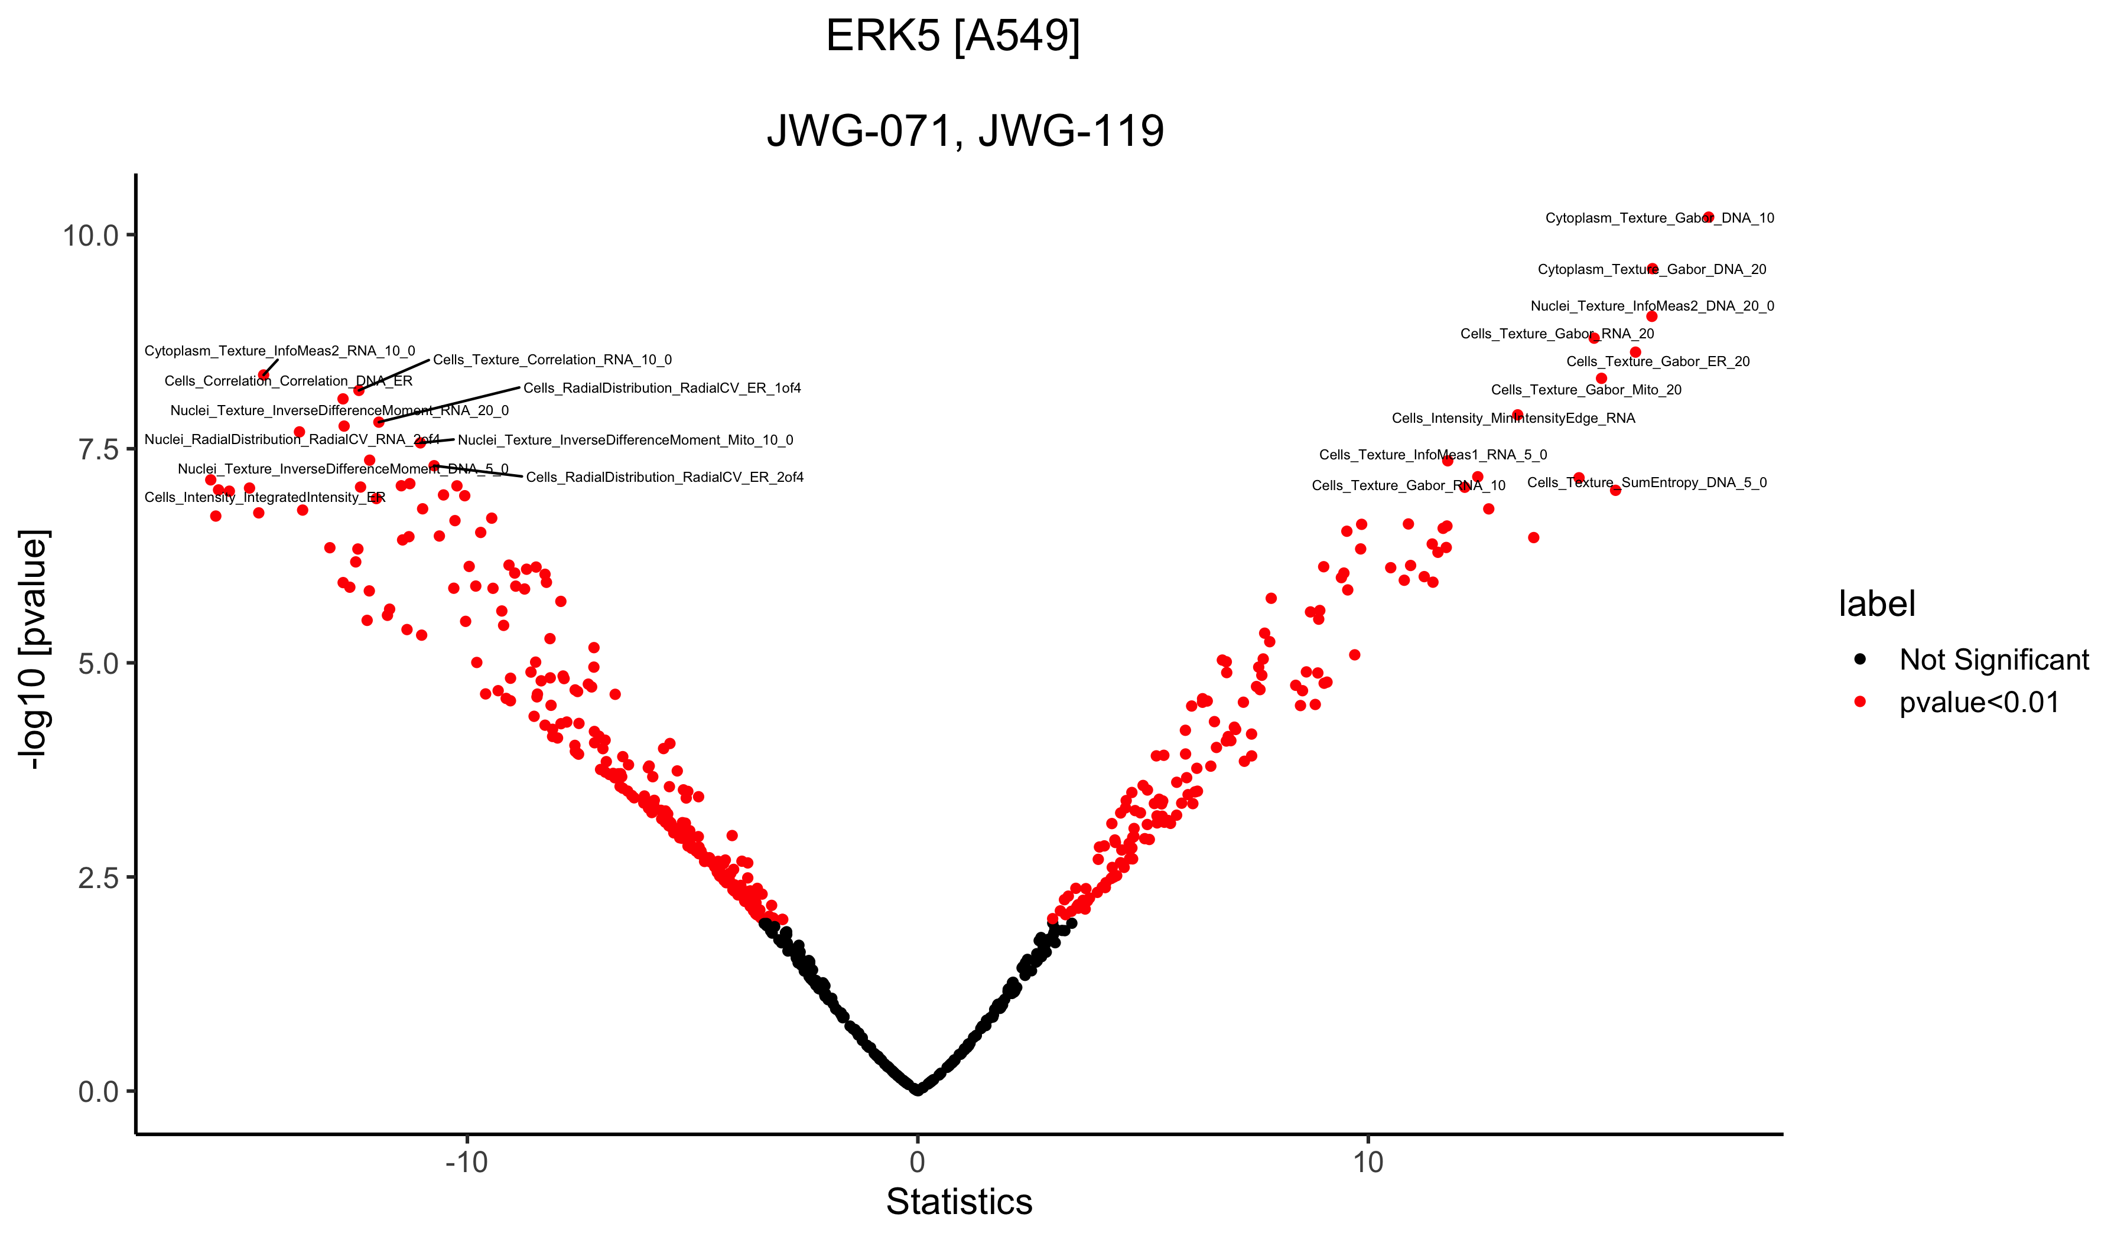
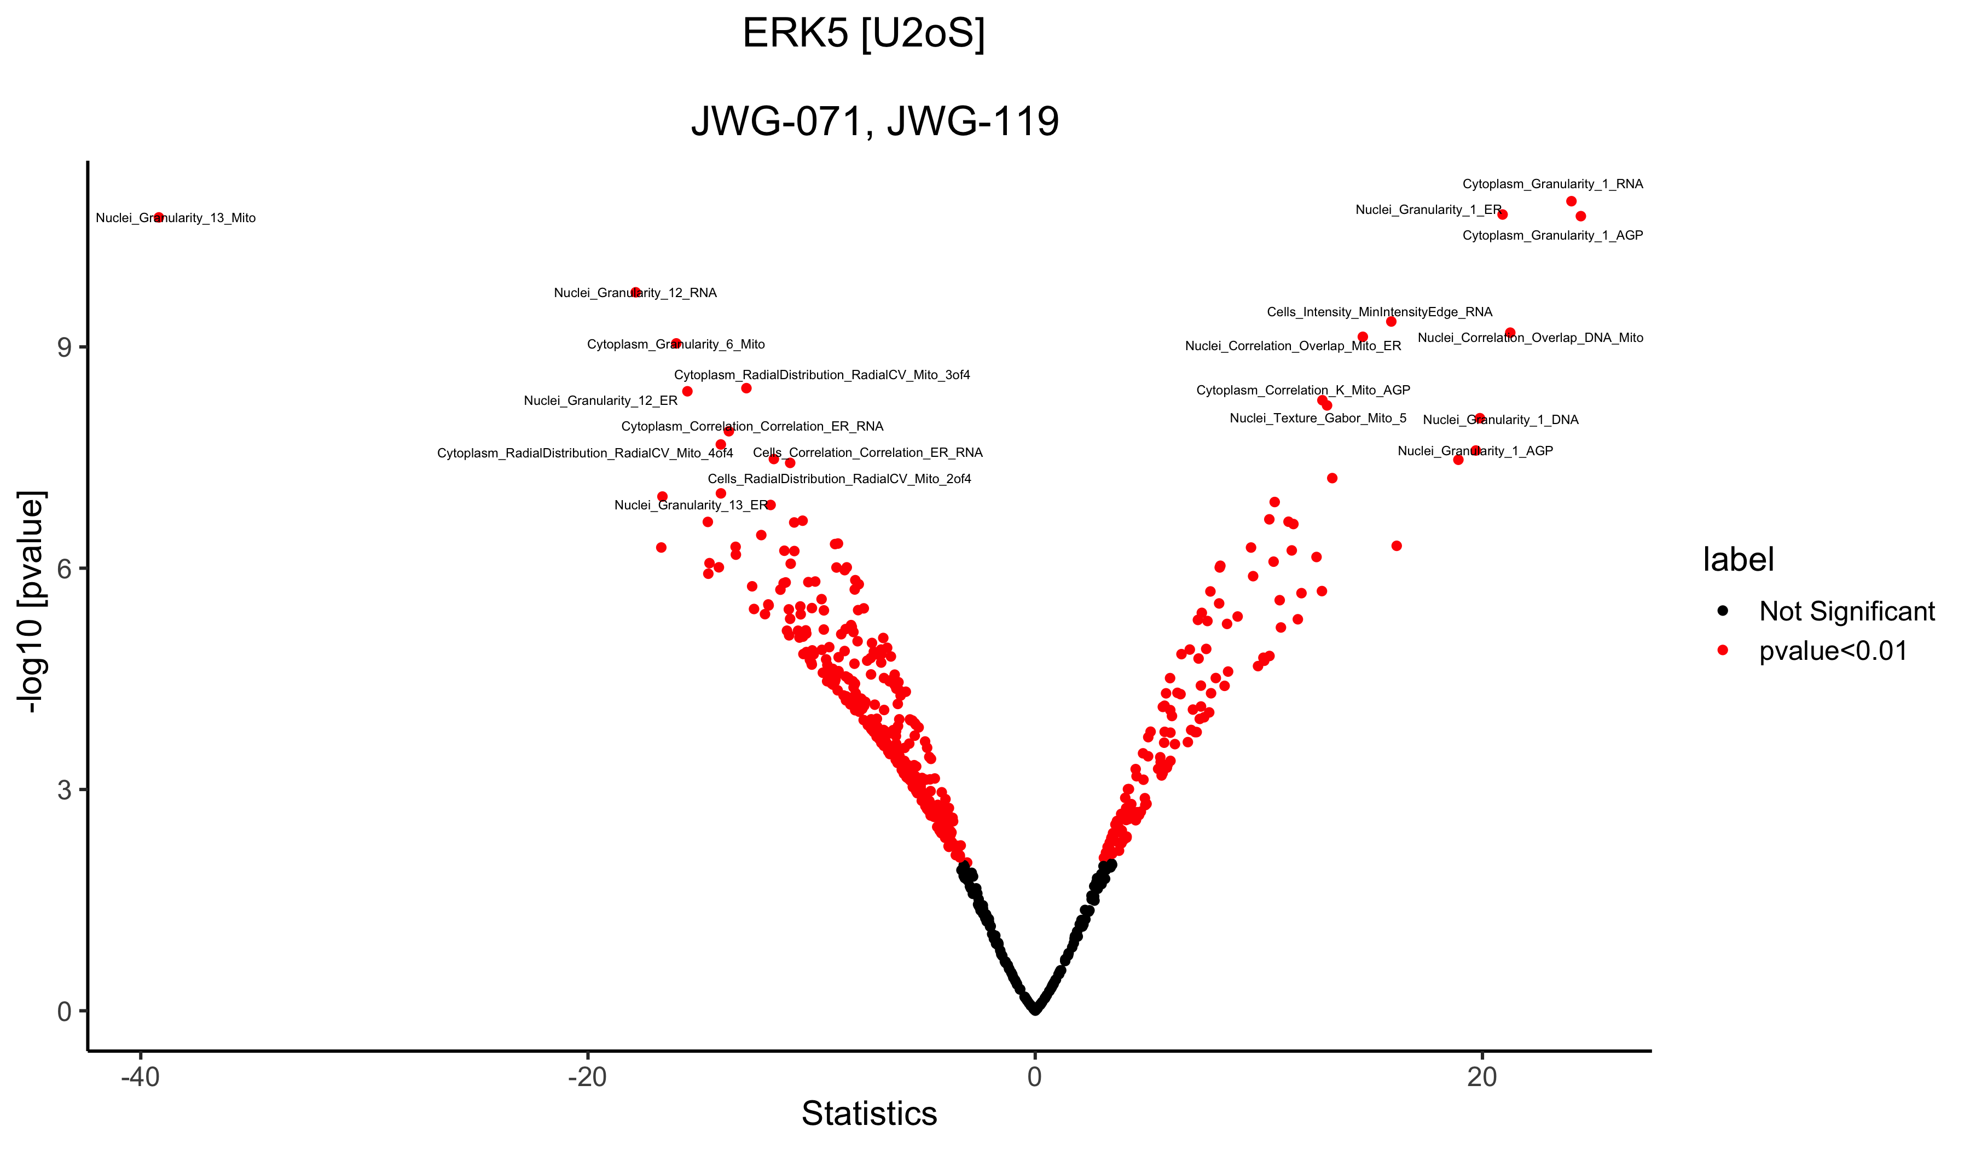
Active
In active
Active
In active
ERK5
Welch's t-test

